Slide 1
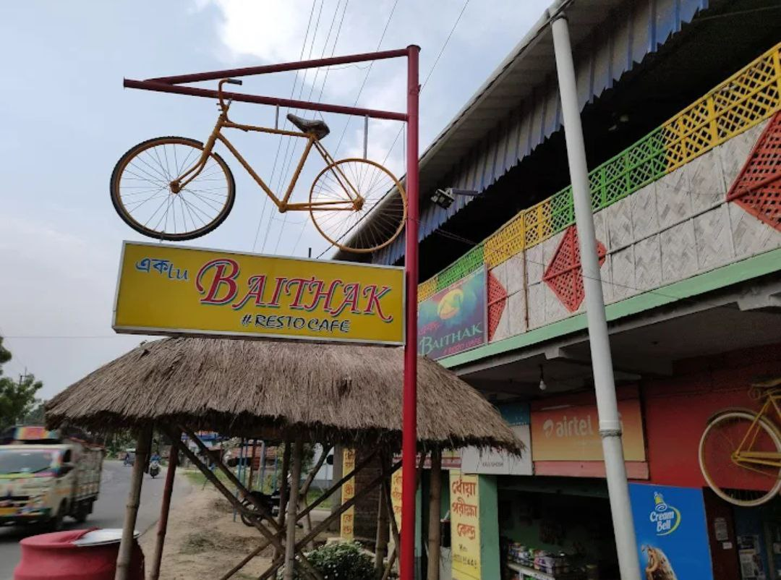


Optimizing Inventory and Maximizing the Profit of a Café Business
Sourasish Ghosh
23f3004075
IITM Online BS Degree Program

Slide 2
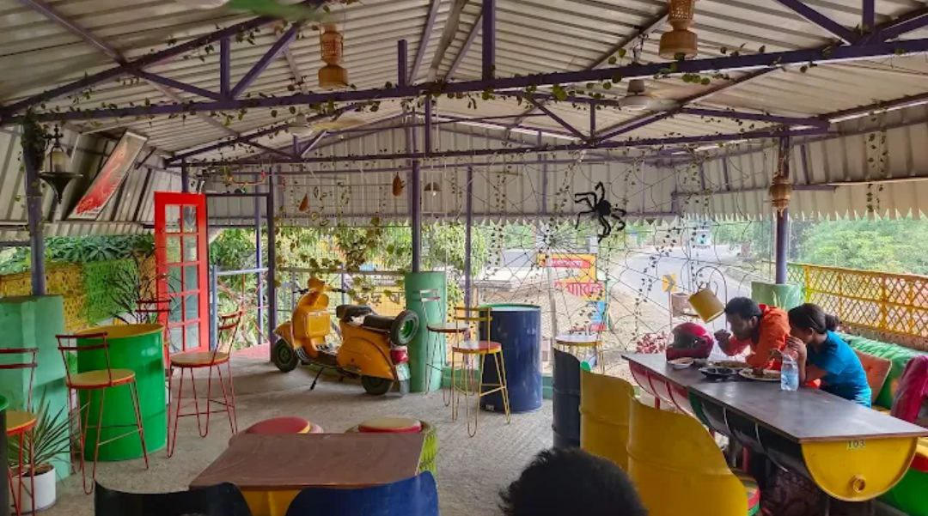
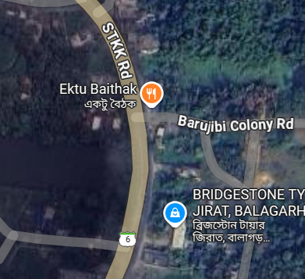
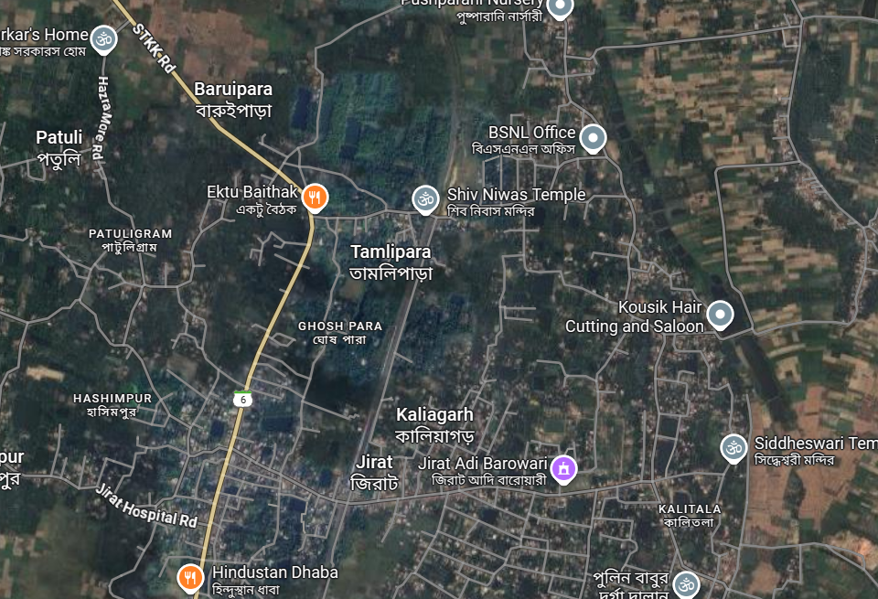
Organization background
Name: Ektu Baithak Café
Location: Tamlipara Bus Stand, Jirat, Balagarh, West Bengal
Established: in 2021 by Mr. Arghya Ghosh
Menu Range:
Biryani (Chicken & Mutton), Rice, Kebabs, Noodles, Drums of Heaven (Chicken Drumstick), Beverages (Tea, Coffee, Soft drinks) etc.
Customer Base: Local residents, students, office-goers, festive season tourists
Staffs: 8 ; Suppliers: 9
Operational Model: Dine-in only, no home delivery yet
Business Challenges:
Profit Optimization
Inventory Management & Wastage

Slide 3
Problem Statement
Inventory Inefficiency
Over-purchasing and mismatch between stock levels and daily demand.
Leads to spoilage and wastage, especially on low-traffic days.
Profitability Optimization
Monthly sales (~2,022 units) fall short of break-even (~3,106 units).
Fixed employee costs remain high year-round regardless of sales volume.
3. Seasonal Demand Fluctuation
High sales during festive months (Oct, Dec–Jan), sharp drops in April–August.
No systematic alignment of purchasing and production with seasonal patterns.
Constraints:
Seasonal Demand Variation, High Fixed Costs, Monsoon Effect on Business etc.

Slide 4
Data Collection and Methodology
Primary Data: Collected directly from Café owner and staff
Data Sources | Justification
Café Sales Data (2024) | Provides annual sales trends and profit margins Helps to identify seasonal patterns (festive peaks, monsoon effects).
Café SKU Data (2024) | Breaks sales down to the product-level Needed for ABC analysis Allows calculation of SKU-wise contribution margins for profit optimization.
Day-wise Sales Data (May–June 2025) | Captures short-term demand fluctuations (weekday vs. weekend, weather effects) Crucial for detecting demand spikes and planning inventory stocking
May 2025 Inventory Data | Directly measures raw material usage vs. sales generated Enables wastage flagging.
- Most of the data was collected verbally and on Google Sheets/Excel.

Slide 5
Data Collection and Methodology
Dataset | Estimated Monthly Sales Data | SKU Sales Dataset | Daily Inventory Data (May 2025) | Daily Sales Data (May–Jun 2025)
Time period | Jan–Dec (1 year) | Jan–Dec (1 year) | 01-05-2025 to 31-05-2025 | 01-05-2025 to 30-06-2025
Granularity & records | Monthly (12 records) | Monthly per SKU (12 x 7 = 84 rows) | Daily start/end per item (31 days x many SKUs) | Daily Customers (≈61 records)
Key variables | Estimated Sales, Employee Costs, Electricity Bill, Raw Goods Cost, Profit Margin, Avg Daily Customers | SKU, Units sold (monthly), Unit price | (Start/End) of stocks for Rice, Chicken, Mutton, Noodles, Coffee, Milk, Potato, Bread, Sugar, Butter, Oil, Onions, Yogurt, Eggs, Flour | Daily Sales INR, Customers, Avg Sale per Customer
Key ranges / metrics | Sales: ₹160k–₹450k; Profit margin: −17% to 50%; Employee cost fixed ₹135k | Unit price: ₹60–₹200; Volume: min ~78 & max ~980; Biriyani highest volume | Staples (rice, chicken, noodles) deplete fastest; condiments low usage | Daily sales: ₹4,580–₹7,880; Customers: 42–77; Avg sale/customer: ₹80.9–₹136.4
Data Collection
Data Cleaning & Preprocessing
Trend & Demand Analysis
Day-Wise Sales and Inventory Analysis
ABC Analysis
Break-Even Analysis
Regression & ‘What If’ Scenarios
Conclusion & Discussion
Fig : Flowchart of Methodology
Analysis Tools: Python (Matplotlib, Pandas, NumPy, SciPy, Seaborn), Google Sheets.

Slide 6
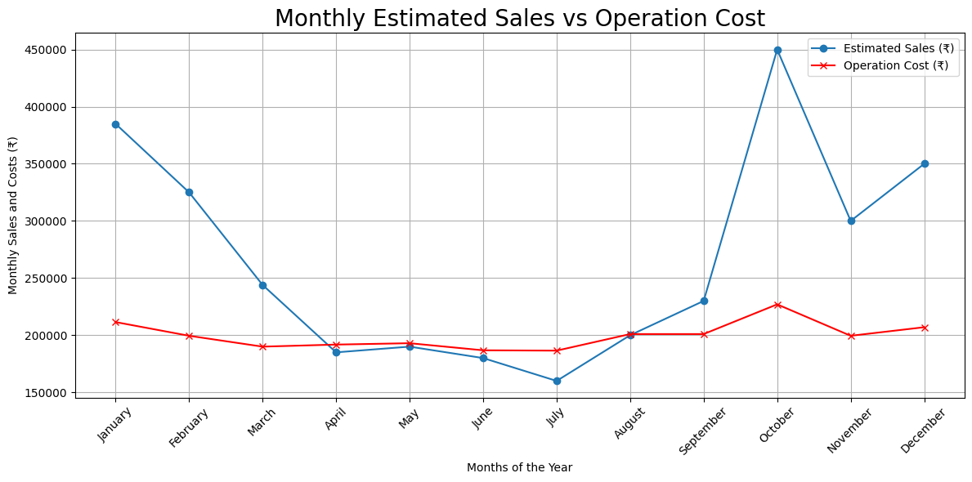
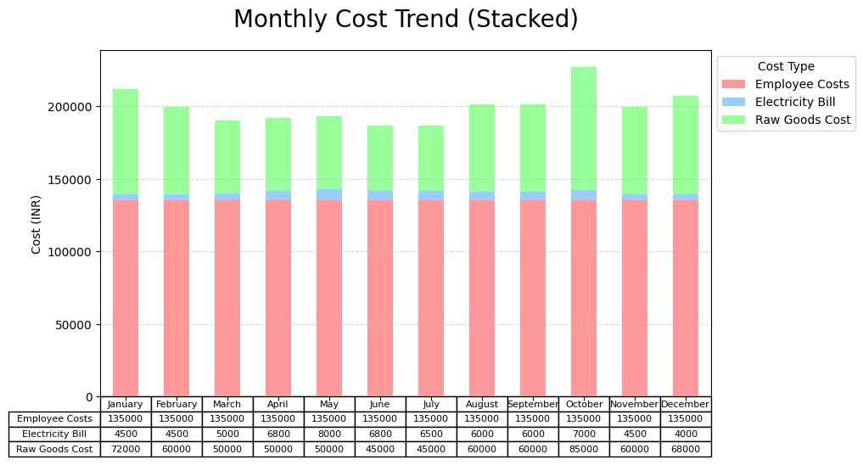
Results and findings
Trend & Inventory Insights:
Monthly Trends:
Peak sales: Oct, Dec–Jan (festive seasons)
Low sales: Apr–Aug (monsoon effect)
Inventory Efficiency: Avg ₹136.9 sales/unit; peaks on weekends & Wednesday
Wastage Days: 05-05-25 & 08-05-25 – high stock, low sales

Slide 7
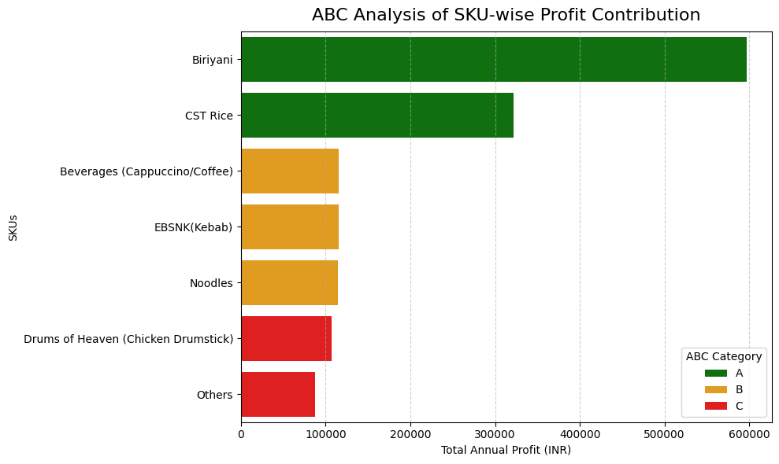
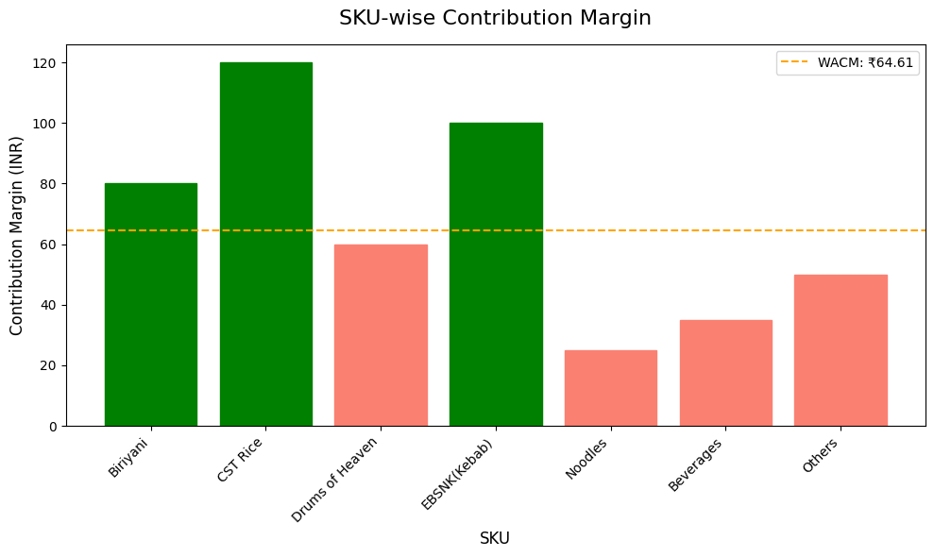
Results and findings
Profit Drivers:
ABC Analysis:
A: Biryani & CST Rice → 63% profit
B: Beverages, Kebab, Noodles → 24%
C: Drums of Heaven, others → 13%
Break-even: Need 3,106 units/month; current ~2,022 (loss situation, shortfall of ~1024 units)
SKU-wise Contribution Margin Findings:
Highest CM: CST Rice (₹120), Kebab (₹100), Biryani (₹80)
Lowest CM: Noodles (₹25), Beverages (₹35)
WACM Threshold: ₹64.61

Slide 8
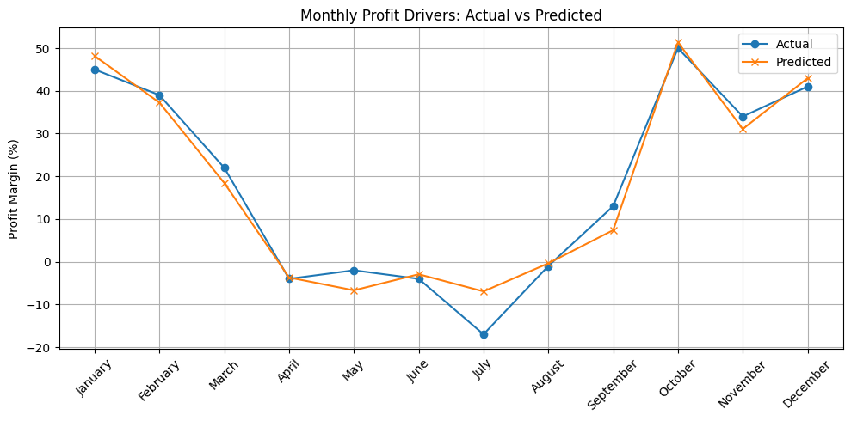
Results and findings
Regression & What-if Insights:
R² = 0.967 → model explains ~97% of profit margin variation
Adjusted R² = 0.948
Significant Drivers:
Estimated Sales → Positive effect (higher sales improves margins)
Electricity Cost → Negative effect (hidden expense hurting profits)
Non-Significant Drivers:
Employee costs (fixed value)
Avg. Daily Customers (weak relationship with margin)
What-if Scenarios:
+10% Sales → Profit Margin ↑ to 25%
–10% Raw Cost → Profit Margin ↑ to 20%
–20% Electricity → Profit Margin ↑ to 22%
-10% Employee Costs →Profit Margin ↑ only slightly (18%)
+15% Customers → Profit Margin ↑ to 17.8%

Slide 9
Interpretation and recommendations
Sales Trends: Seasonal peaks (Oct, Dec–Jan), slump in Apr–Aug → profit loss in low-demand months.
Cost Structure: Employee cost fixed & highest share; raw goods fluctuate → drives margin variation.
Inventory Efficiency: Average ₹136.9 sales/unit, but flagged wasteful days (05 & 08 May) → mismatch of stock vs. demand.
SKU Profitability: Category A (Biryani, CST Rice) = 63% of profit; Category C items add cost but low returns.
Break-Even Gap: Needs 3,106 units/month vs. actual 2,022 → consistent shortfall.
Regression Insight: Sales growth & raw cost control = strongest profit levers; electricity also impacts margins.
Inventory Management: Daily audits, FIFO, real-time dashboard, supplier coordination
Profit Growth: POS system, temporary staff in peak seasons, high-margin SKU focus, home delivery
Visual: Icons for each recommendation (POS, truck for supplier, dashboard, delivery bike)

Slide 10
Thank you !
With the analysis, interpretation and recommendations; the business can hopefully overcome their problem.

